Slide 1
SpeakLeash initiative for Polish foundational LLMs
Speaker: Szymon Mazurek

Slide 2
Presentation plan
Project overview
Pillars of the project
HPC component - some benchmarks
Future directions

Slide 3
SpeakLeash project
Open initiative of volunteers
Started in 2023
Initial goal - 1TB of Polish text data
Currently - more than 1000 (!) people involved
Data goal reached (with a large overshoot!)
Heading for the best performance in benchmarks for Polish language

Slide 4
Data collection and curation
Text scrapped from the Web
Cleaning and processing - a key element
Crucial speedups using HPC for data deduplication and classification
Classification made with ANN

Slide 5
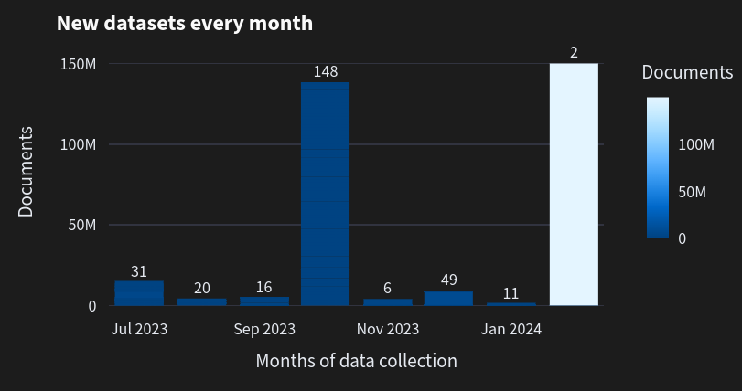
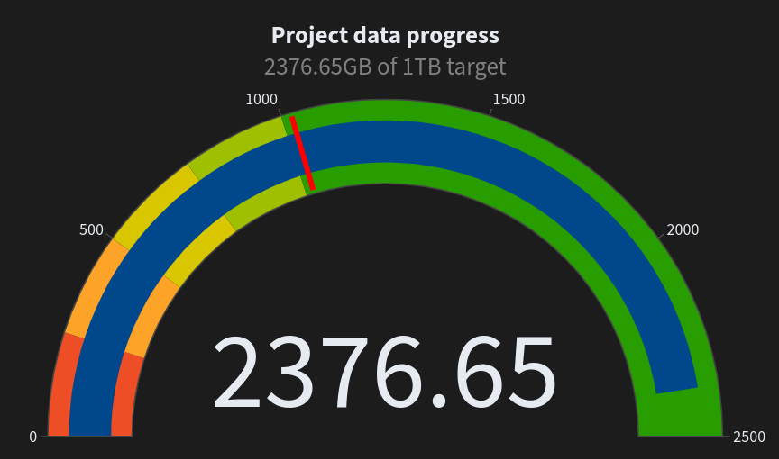
The data - some numbers

Slide 6
SpeakLeash - foundational models
ALLAMO and Megatron frameworks for training the models
Several iterations on training foundational models (7B, 10B and 11B)
Models trained in various configurations - from scratch, SFT with instructions, continuation of training of existing models
Different combinations of data mixtures and languages tried
Tokenizer tuning
Multimodal model for v3 in progress

Slide 7
Benchmarking
Continuous benchmarking allowed via HPC access
New benchmarks defined for Polish language
Several models evaluated
MT-Bench for Polish Language created and released
Inference API hosted by Cyfronet for model testing

Slide 8
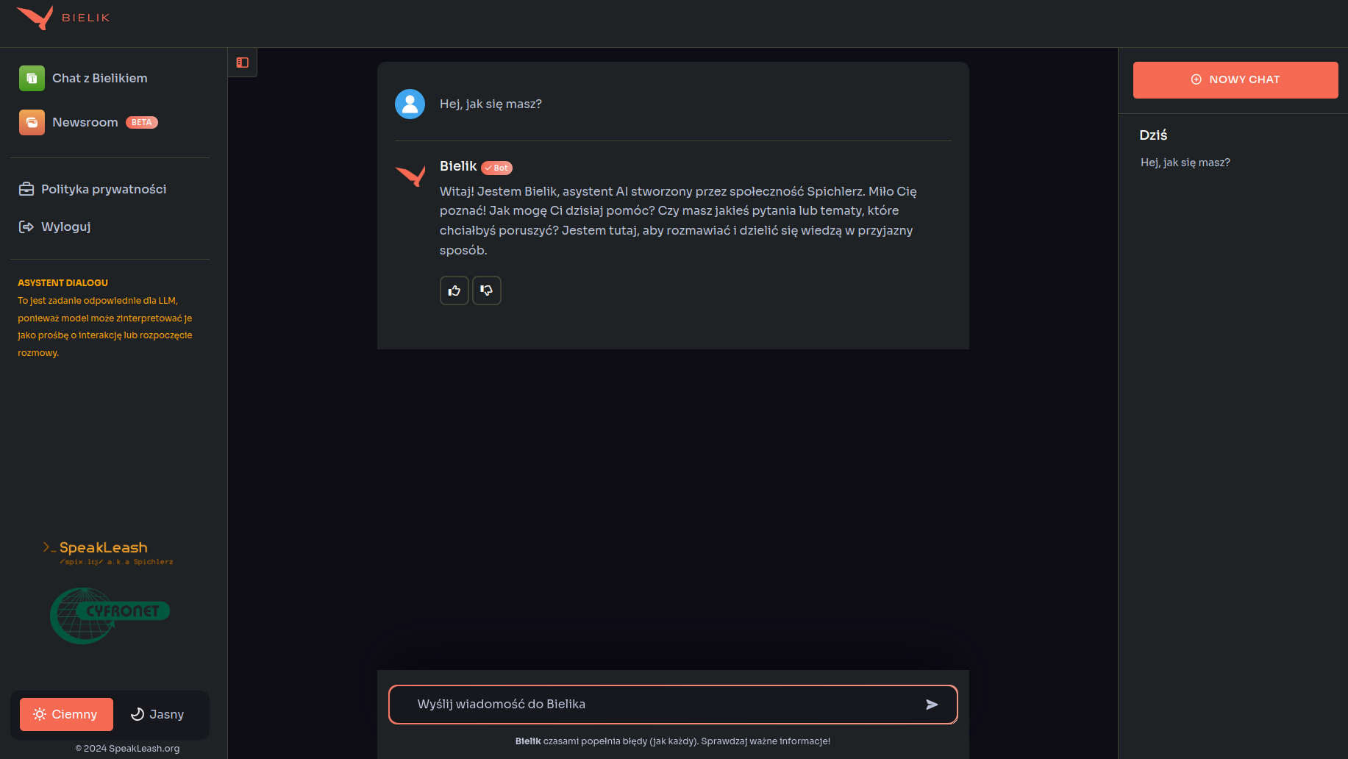
Test panel

Slide 9
Benchmarking - PL LLM Leaderboard
Scoring of the models in variety of benchmark tasks in Polish language

Slide 10
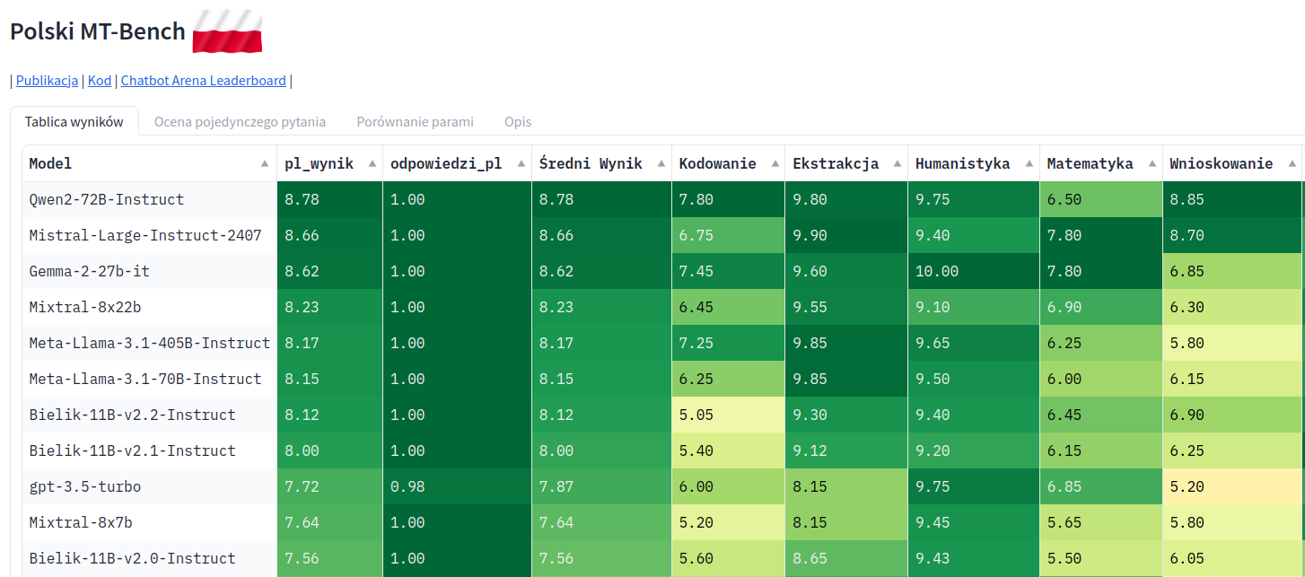
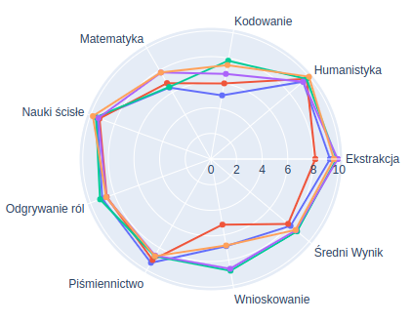
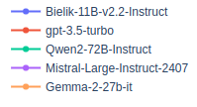
Benchmarking - PL MT-BENCH
Two models respond to the same task - metamodel as the judge (GPT 4 in this case)

Slide 11
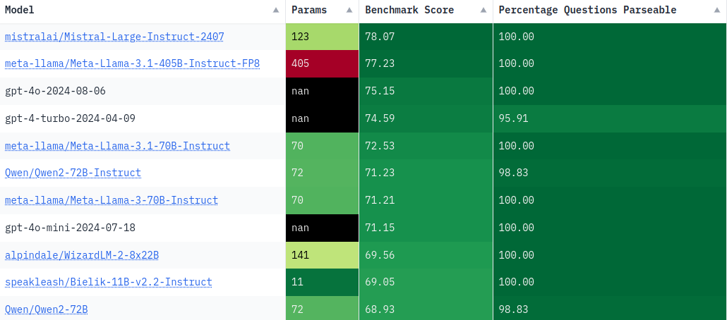
Benchmarking - Polish EQ-Bench
Understanding of complex emotions and social interactions, emotion prediction accuracy

Slide 12
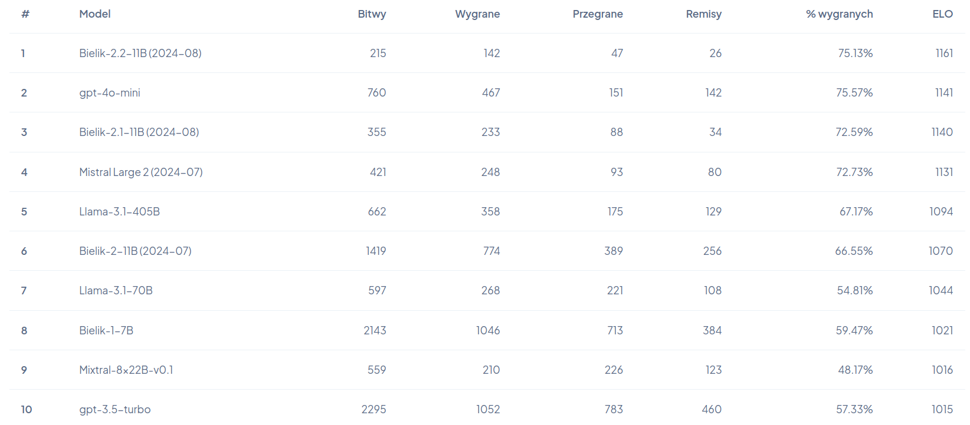
Benchmarking - Chat Arena
Model vs model scenario - user gets multiple responses, then judges which is better
Answers not limited to Polish language
ELO as the ranking metric
Additional functionalities - Bielik vs the world, Newsroom

Slide 13
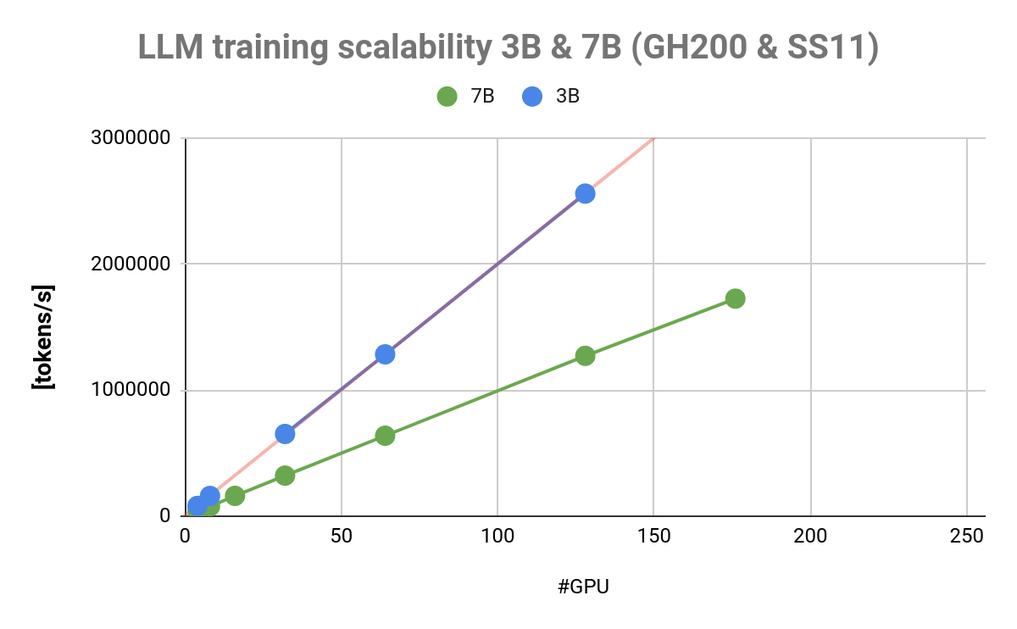
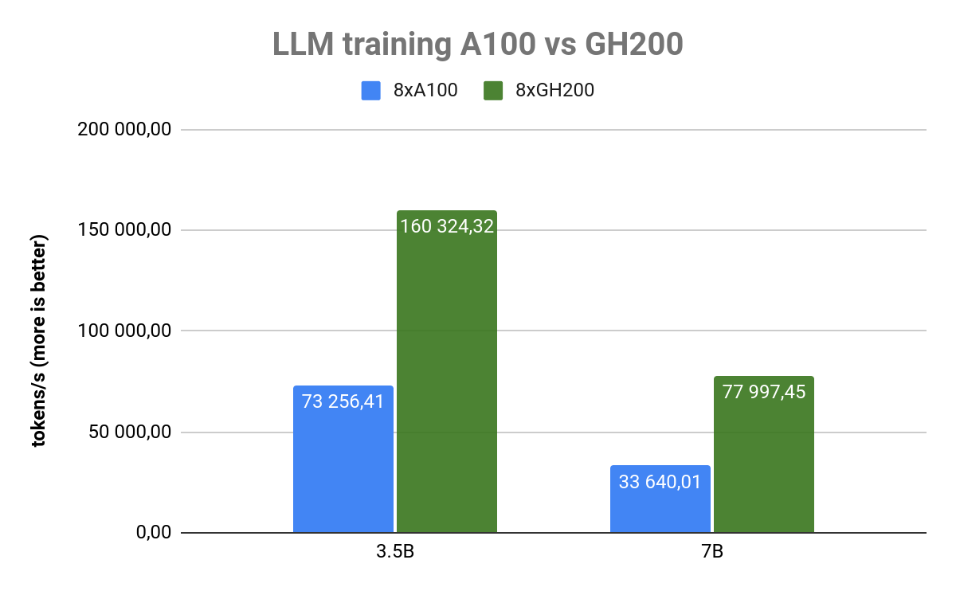
Model training - observed speedups
Initial model trained on private RTX 4090 - 1B params, 45 days, 67 110 961 152 tokens
The same setting with 64 GH200 - 5 hours

Slide 14
Benefits for SME ecosystem
Open source data, models - free to use
Compact model size - vendor independence, lower deployment costs, privacy
Access to the knowledge - open development process
Use cases (to date, known):
law document analysis
medical document analysis
internal assistants

Slide 15
The future
SpeakLeash website
Multimodal model (work in progress already)
Further collaboration with business and open science
Knowledge transfer - preparing course/tutorial materials
HuggingFace card is there! huggingface.co/speakleash

Slide 16
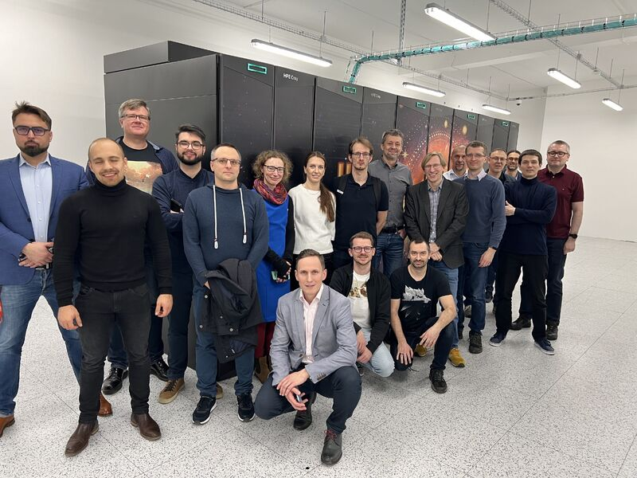

Slide 17
Thank you for your attention!
Funded by the European Union. This work has received funding from the European High Performance Computing Joint Undertaking (JU) and Germany, Bulgaria, Austria, Croatia, Cyprus, Czech Republic, Denmark, Estonia, Finland, Greece, Hungary, Ireland, Italy, Lithuania, Latvia, Poland, Portugal, Romania, Slovenia, Spain, Sweden, France, Netherlands, Belgium, Luxembourg, Slovakia, Norway, Türkiye, Republic of North Macedonia, Iceland, Montenegro, Serbia under grant agreement No 101101903.

